Slide 1
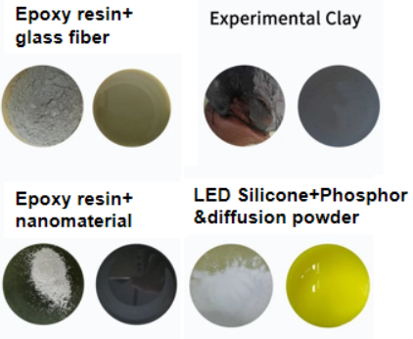
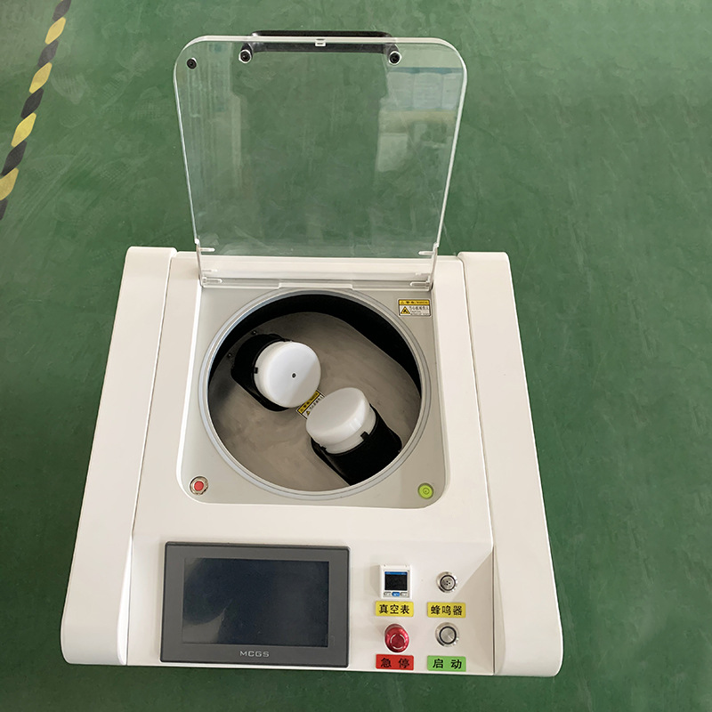
S-PM750V Epoxy Resin Mixer
Epoxy Resin Mixer Serial
Description
Suitable for mixing Epoxy Resin, also other materials, such as
LED photoelectric, Siler paste, Nano powder material and so on
Features
Rotation/revolution with a high power vacuum pump
Can mixing high-viscosity material using 2 centrifugal force: rotation and revolution in a short time
Large capacity: Maximum 1500ml (2*750ml)
Up to 11 preset programs (Can be customized), suitable for different types materials
Max rotation speed up to 2000rpm
Time control setting: Accurate to 1s
Convenient running: Touch screen & obvious button
Highly stability in use

Slide 2
S-PM750V Epoxy Resin Mixer
Epoxy Resin Mixer Serial
Specifications
Model | S-PM750V
Machine Size(L*W*H) | 681*686*740mm
Mixing Capacity | 750ml/jar, 2 jars/time
Mixing Method | Centrifugal mixing + Vacuum
Mixing Angle | 45°
Power | 1.2KW
Applicable temperature, humidity, and voltage | 10-45℃, 20-80%RH, Ac220V 50/60HZ
Running Speed | 200-2000rpm
Vacuum Pump | Oil-free Vacuum Pump (can choose external oil-sealed)
Vacuum Degree | 35mba(6mba)~1atm, accuracy 0.01KPa
Vacuum Flow Rate | 100L/Min*2
Control Mode | Variable Frequency Drive Control, Touch Screen Preset, Human-machine Interface
Weight | 120KG
Spindle Cooling Mode | Normal Air-cooled(can choose Oil-cooled: Continuous operation for more than 30 minutes or high-speed rotation in a single instance)
Safety Protection Device | Cannot start operation when the upper cover is not closed, emergency stop, motor overload alarm, automatic stop when a fault occurs
Program Storage Capacity | 11
Setting Time | 1-999s( Totally 5 steps), Accurate to 1s
Transmission Ratio & Mode | Mechanically constant(Optional rotation and revolution, separately adjustable from 10-100%). Gear Transmission

Slide 3
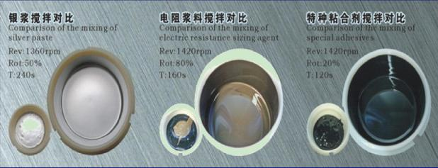
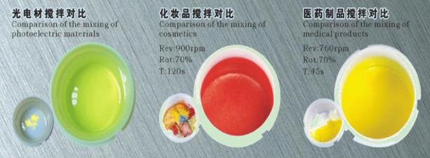
S-PM750V Epoxy Resin Mixer
Epoxy Resin Mixer Serial
Material Mixer Video & Pictures

Slide 4
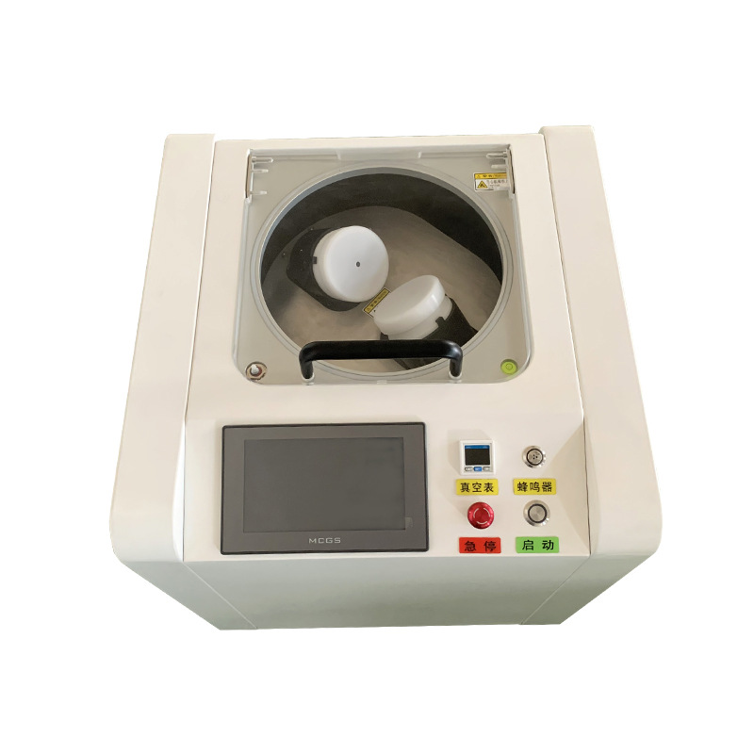
S-PM750V Epoxy Resin Mixer
Epoxy Resin Mixer Serial
7 Benefits for Choosing S-PM750V
High running speed (up to 2000rpm): bubble removal quickly
Lower noise
Better stability
Clearly Buttons for control
High sealing performance
Durable bearing: smooth rotation
High durability: use famous brand motor

Slide 5
Best After-sales service
— Free Installation/ Training
— 1 day lead-time (spare parts)
— 5 days customized design
— 7x24 Worldwide Support

Slide 6
Welcome Inquiry
Please visit
www.smthelp.com
Find us more
https://www.facebook.com/autoinsertion
Know more our team
https://www.linkedin.com/company/smtmachine
Welcome to our factory in Shenzhen China
See more our machine please Google
Auto Insertion
Youtube
https://www.youtube.com/c/Smthelping
Looking forward to your email
info@smthelp.com

